Slide 1
Group Project:
Capsule Hotels in America
April 12, 2018
Dr. Saba
Submitted as partial fulfillment for the requirements of MGMT 345: Global Enterprise
By: Abdulaziz Alabaykan, Ahdenae Khodaverdian, Matt Takla, and Qize Zhao
Notes:
Qize

Slide 2
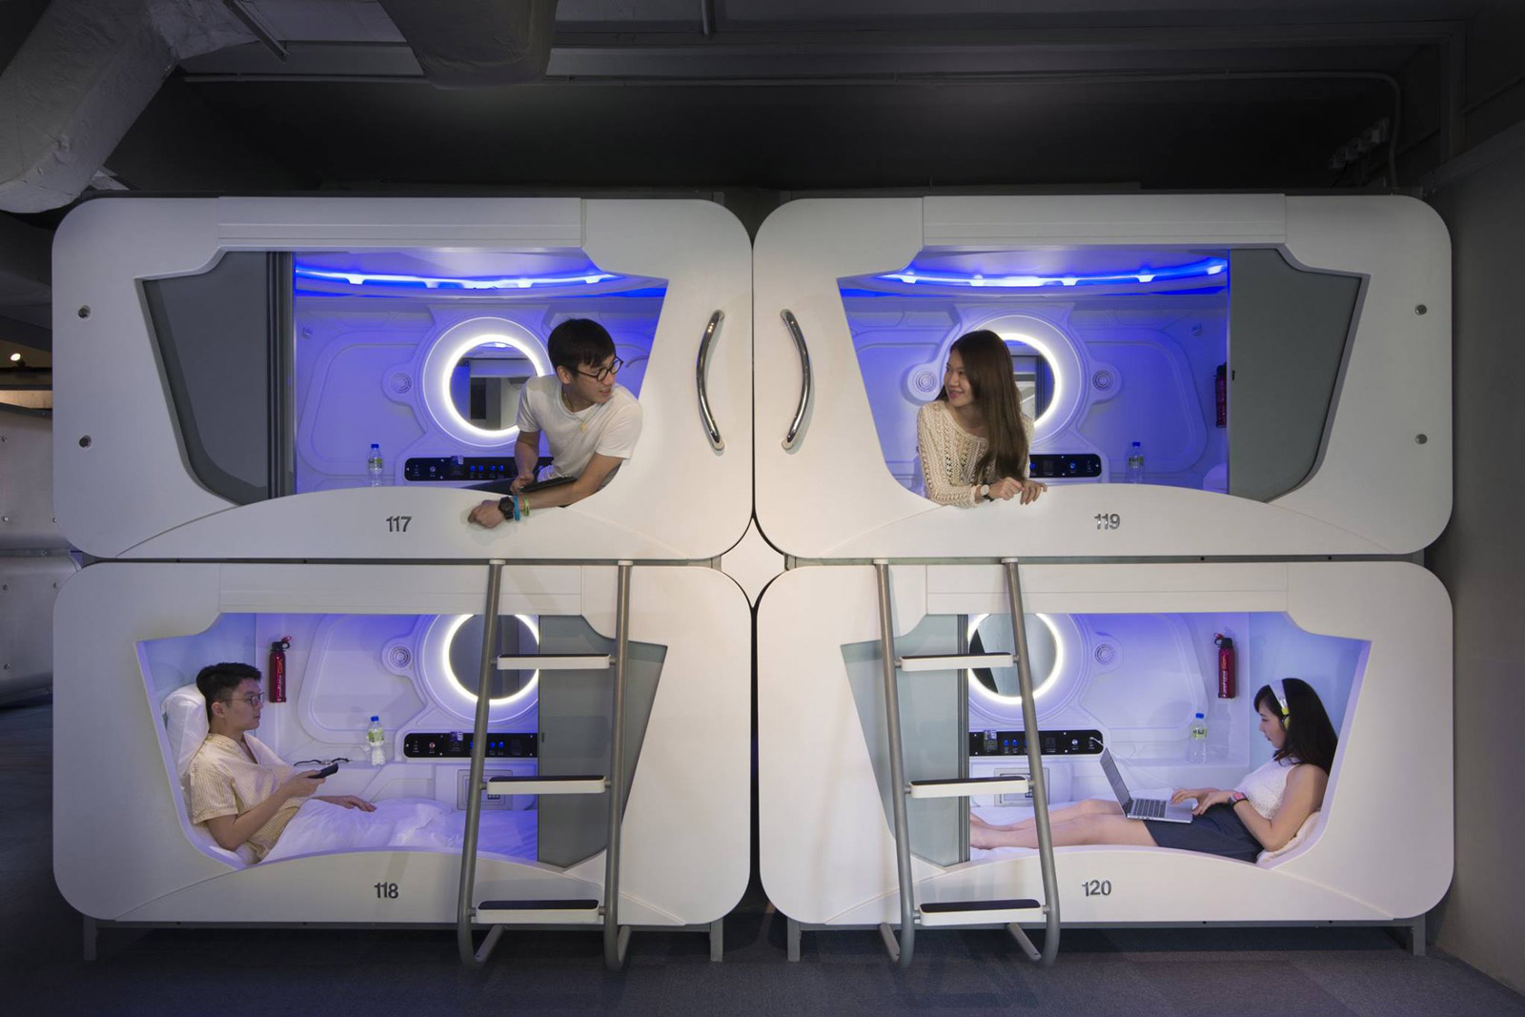
Overview
Define “Capsule Hotel”
History of Capsule Hotels
Expanding from Japan, to Asia, to Europe
The Growth of Capsule Hotels
Japanese vs. American Culture
Three Market Options
  Bare-Bones Model
  Middle Market Model
  Luxury Model
S.W.O.T. Analysis
Our Recommendation
Plan of Action
Managerial Implications
Notes:
Qize

Slide 3
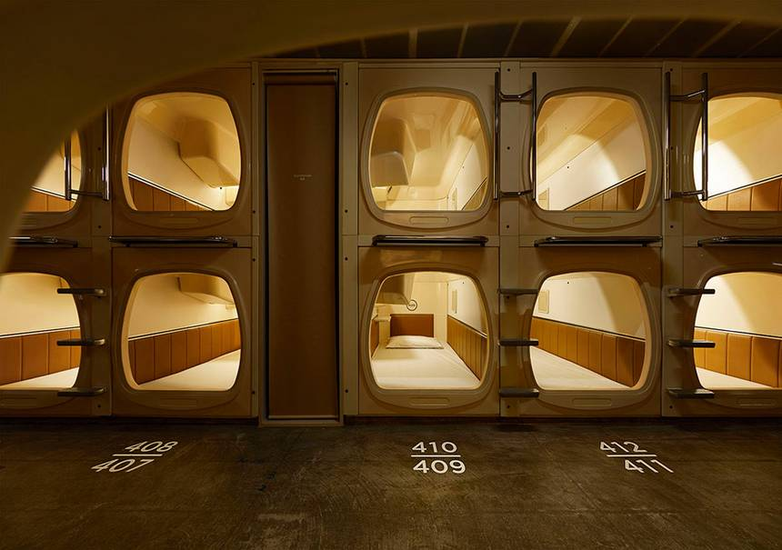
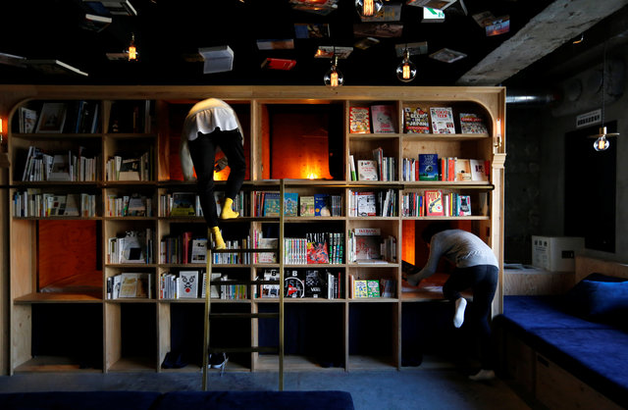
What is a Capsule (Pod) Hotel?
A capsule hotel, also known as a pod hotel, is a type of hotel developed in Japan that features a large number of extremely small "rooms" (capsules) intended to provide cheap, basic overnight accommodation for guests who do not require or who cannot afford the services offered by more conventional hotels.
The motivation behind the pod hotel innovation was to have businesspeople and travelers with smaller budgets get cheap and safe accommodation.
(Weburbanist,2011)
Notes:
Qize

Slide 4
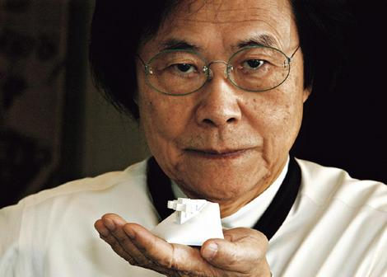
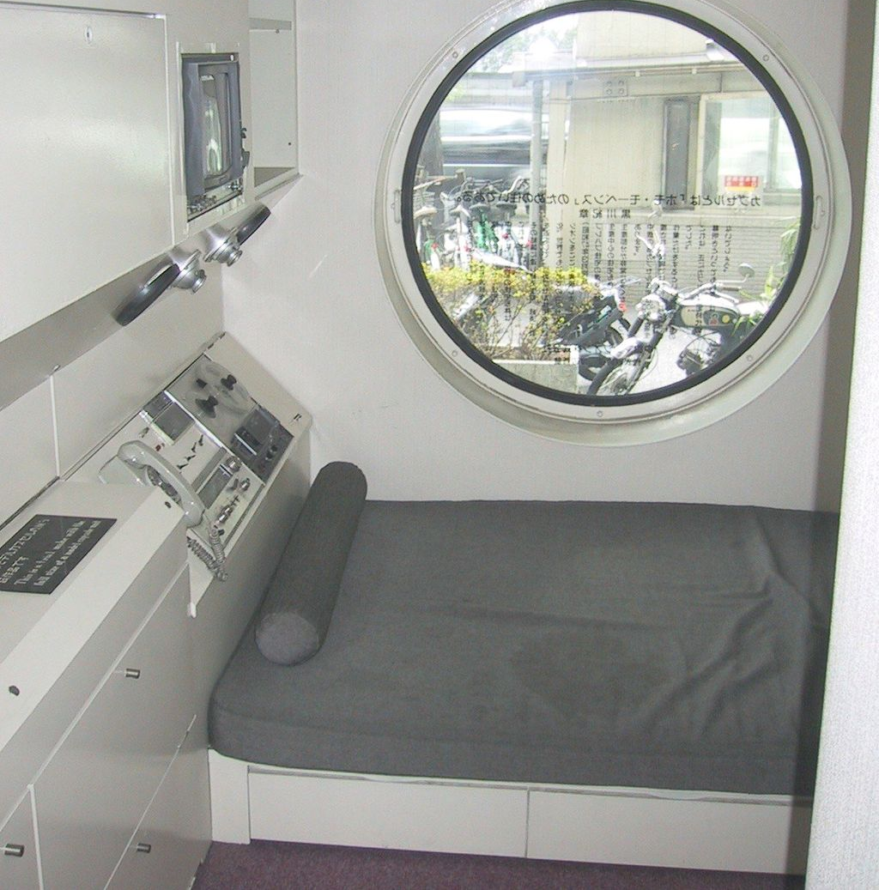
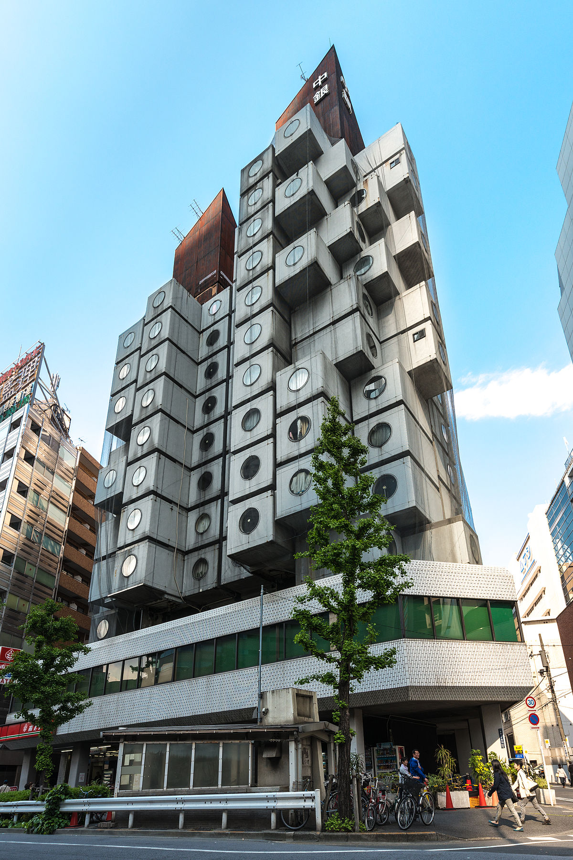
History of Capsule Hotels
Founder: Kisho Kurokawa
  One of Japan's leading architects of the 20th century
  One of the founders of the Metabolist movement of the 1960s
    Principles of the Metabolists revolved around ideas of impermanence and change
    The movement was intended to have more in common with natural processes
    Japanese buildings before World War II were made of timber, so the devastation of the Second World War completely obliterated cities in Japan
      With the frequency of natural disasters in Japan, meant that the Japanese are used to rebuilding cities from scratch.
    Original group disbanded in the early 70s, and Metabolist ideals came to be seen as a historical product of utopian 1960s thinking.
In 1972, Nakagin Capsule Tower, a building made up of prefabricated micro-apartment "capsules" that were designed to be added and replaced as necessary during the building's lifespan.
  Building has recently struck a preservation debate, with a few serious proposals to replace the units as the original design intended, and other advocating its historical preservation.
  Rooms, as of 2015, are still open for rent.
(Scott, 2017)
Notes:
Qize

Slide 5
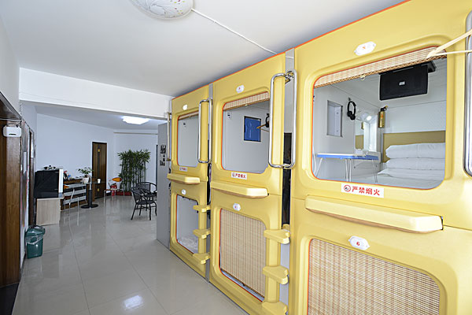
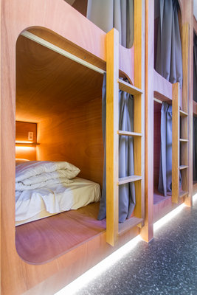
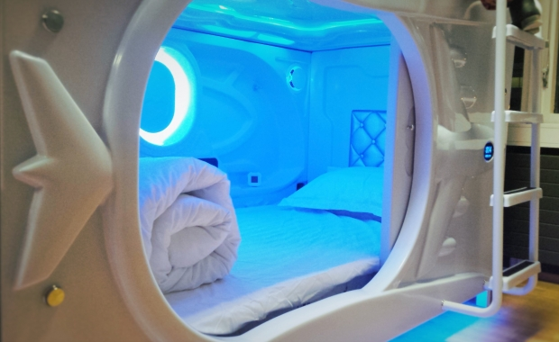
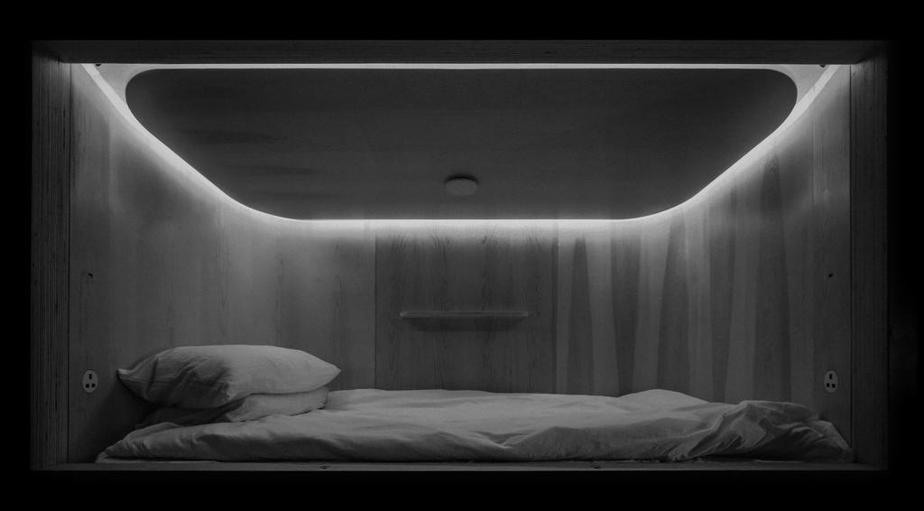
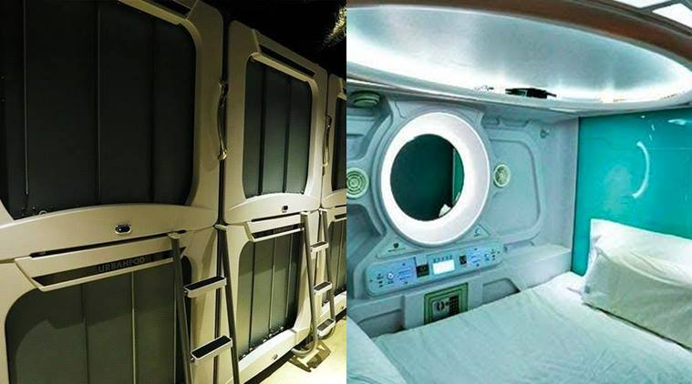
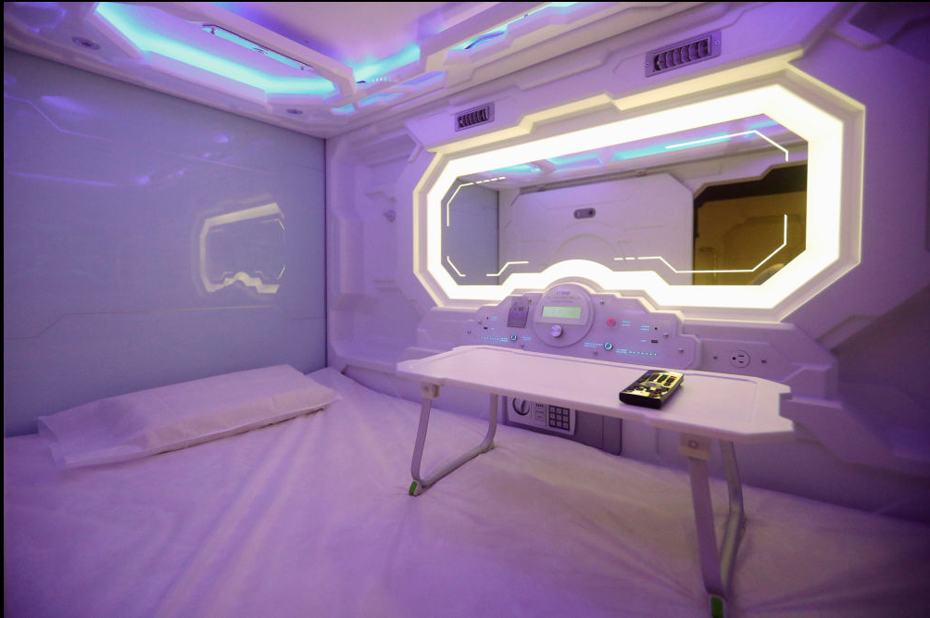
Expanding from Japan, to Asia, to Europe
2012 China’s first capsule hotel opens in Xi’an
2014 Belgium opens Europe's first capsule hotel
2015 Iceland opened the first capsule hostel in Reykjavik.
  Reykjavík’s first Capsule Hotel offers Japanese-style sleeping pods
2017 The first capsule hotel opened in Hong Kong
2017 India’s first Capsule hotel has opened in Mumbai
2017 The first capsule hotel in Mexico was opened at Mexico City Airport Terminal 1.
(CNN, 2012)
(CTV new, 2014)
(Iceland magazine, 2016)
(Boutique hotel news, 2017)
(Indian express, 2017)
(Aol, 2017)
Notes:
Qize

Slide 6
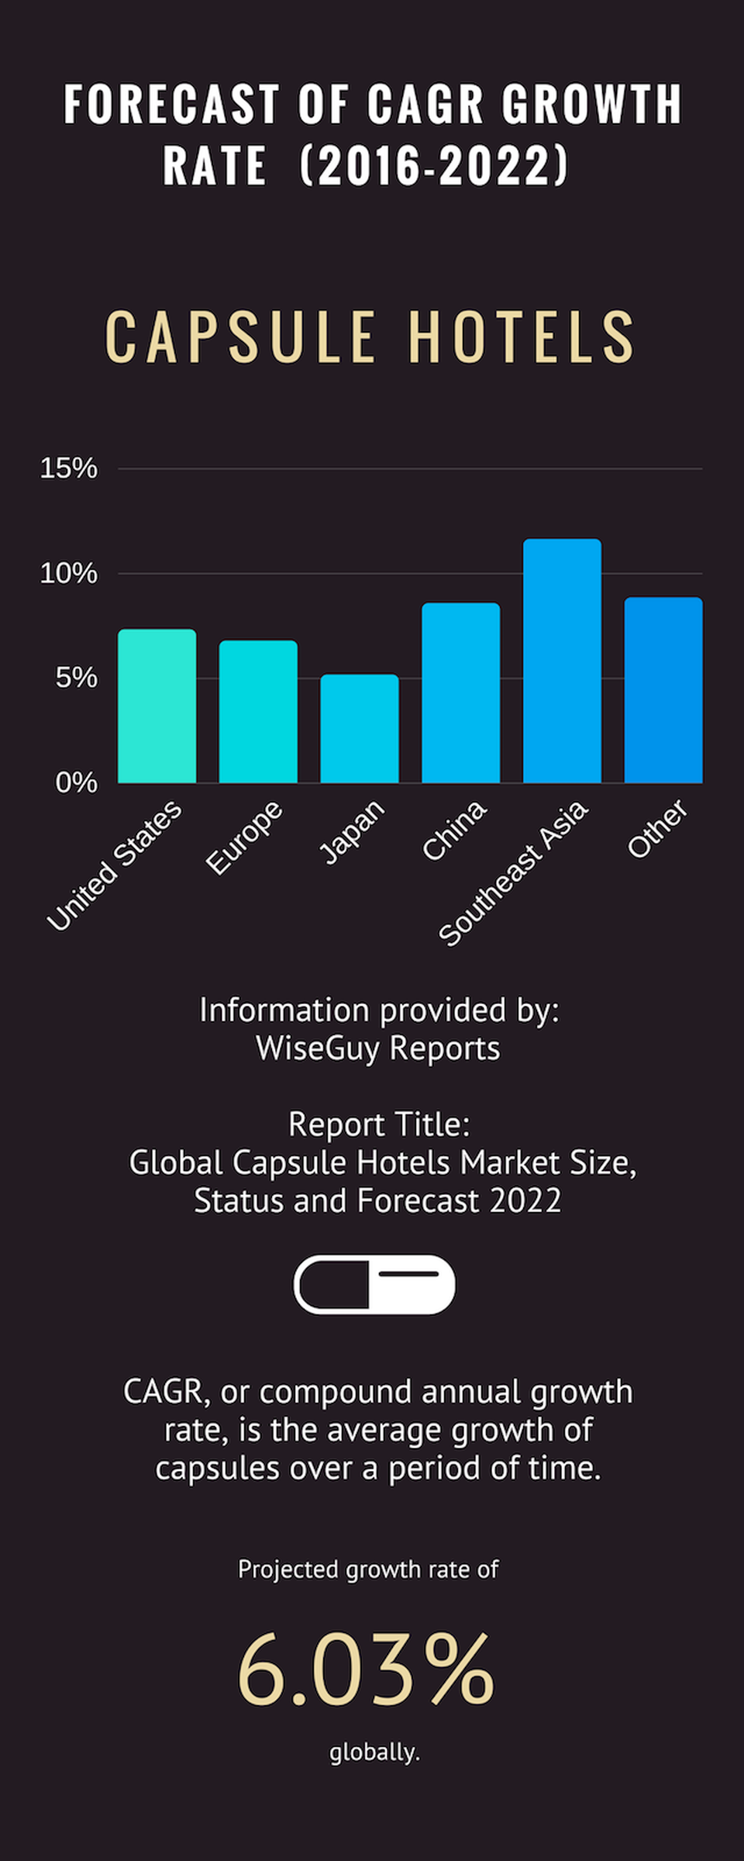
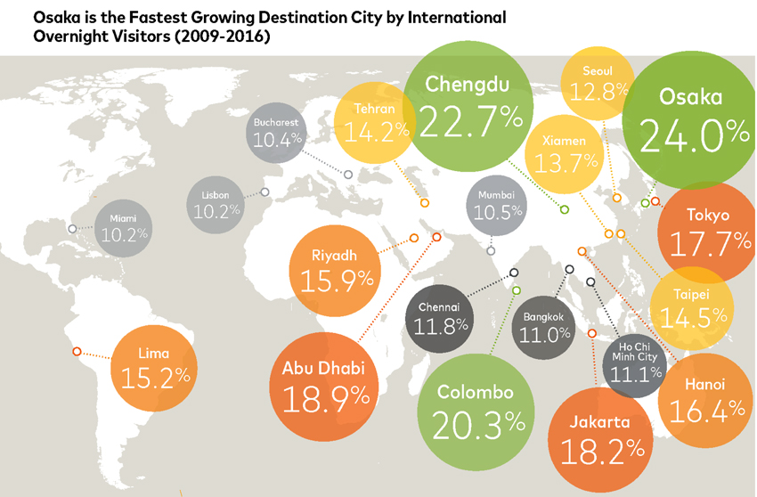
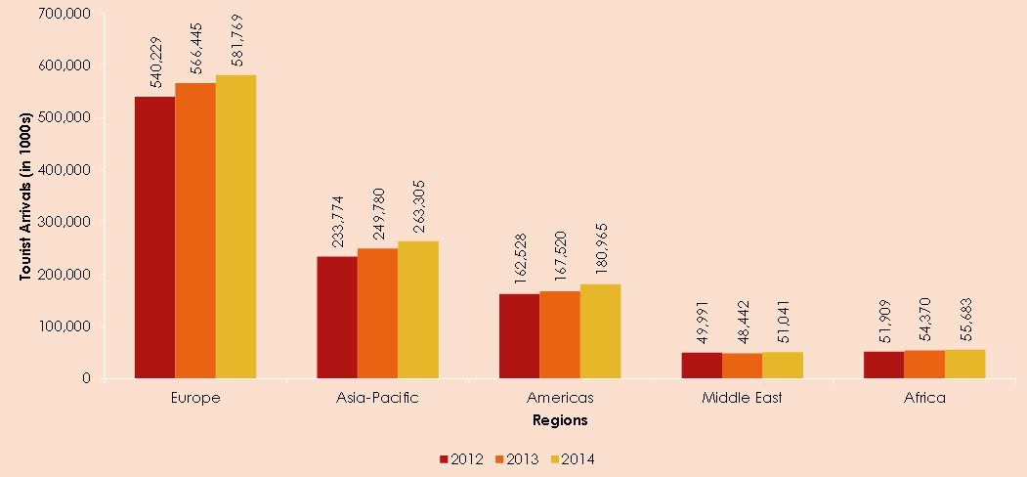
The Growth of Capsule Hotels
Airports
  Travelers looking to spend a night before next morning travel would naturally find the pod concept convenient
Entertainment joints
  Capsules are also perfect for revelers seeking to have a night out but are too drunk or exhausted to go home.
Global capsule hotels market was valued at 159 million USD in 2016 and is expected to reach 226 million USD by the end of 2022, growing at a Compound Annual Growth Rate of 6.03%.
(Abcnews,2011)
(Forbes, 2017)
Notes:
Qize

Slide 7
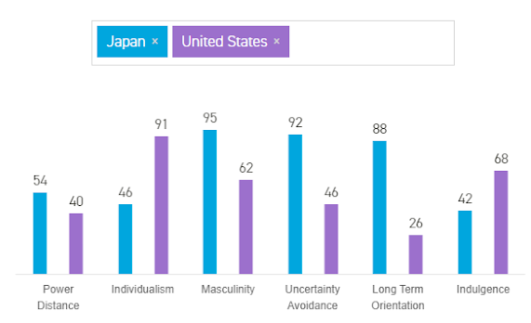
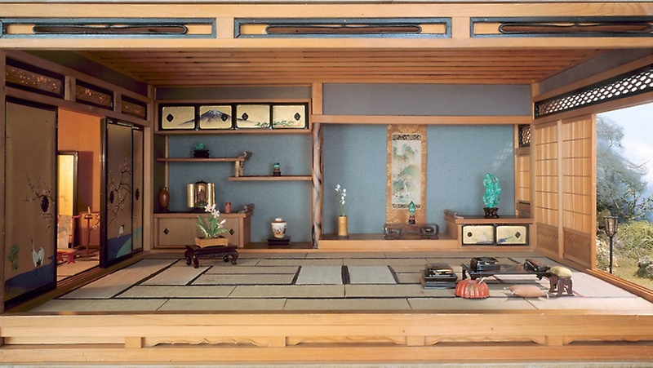
Japanese vs. American Culture
Geert Hofstede’s Cultural Dimensions
  Individualism vs. Collectivism:
    In Japan, one is defined by referring to the relationships one has with others.
    Sentimental desire for ittaikan (“feeling oneness”)
    Japanese individuals are much more open to communal commodities
Japanese communication style is indirect whereas American communication style is direct
Japan and America have a strained history
(Gudykunst, 1994)
(Country Comparison, 2018)
Notes:
Ado
History: Isolationist leading to nationalism, Hiroshima and Nagasaki, Pearl Harbor

Slide 8
Three Market Options
Notes:
None

Slide 9
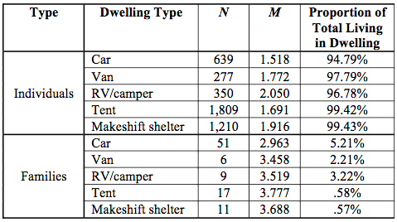
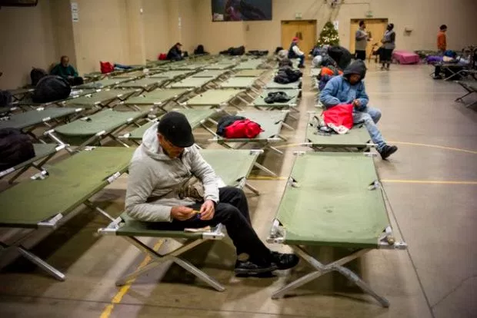
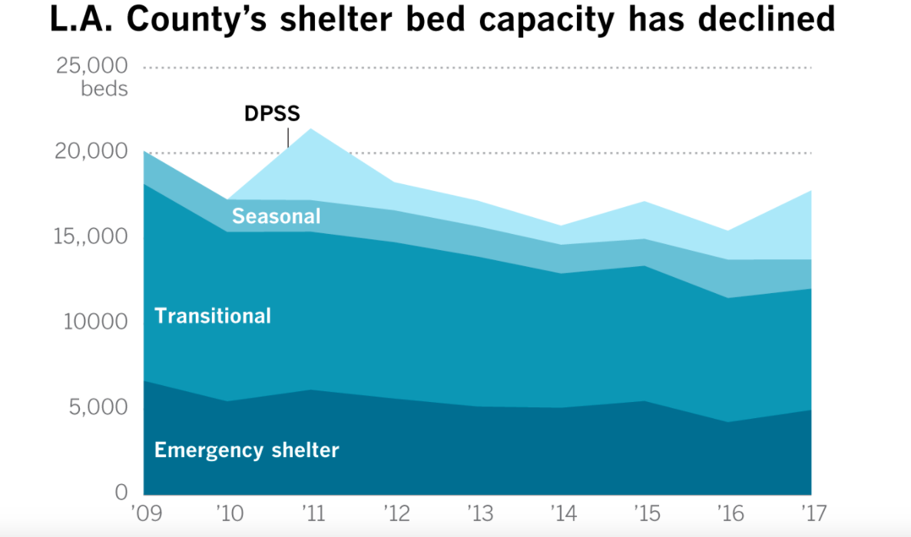
Bare-Bones Model
Non-profit Approach
Target Audience: LA’s Homeless Population
  Provide low-cost alternative to motels or hostels
    $30 per night as opposed to $50-100
  Would be more open to the idea of enclosed, small sleeping arrangements
Includes only essentials:
  Sleeping pod and bathrooms with showers
  Issue of sanitation and security
Opportunity: Solve the issue of finding shelter for homeless populations
  In 2017: 9,587 Individuals... were counted during the unsheltered... count…
  57,794 experiencing homelessness on a given night
(Los Angeles Homeless Services Authority, 2017)
Notes:
Ado
“National Disgrace”

Slide 10
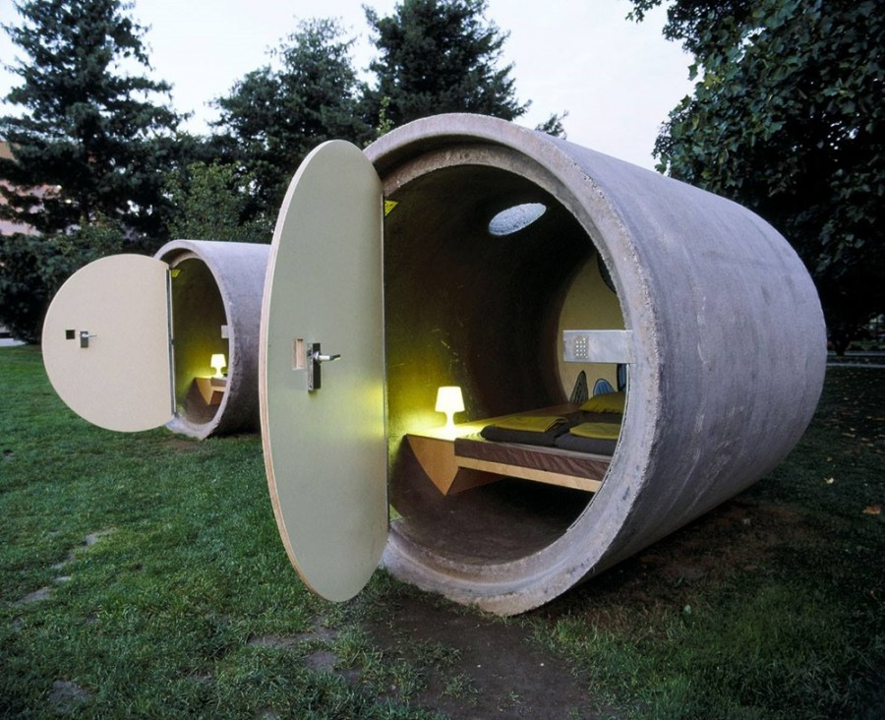
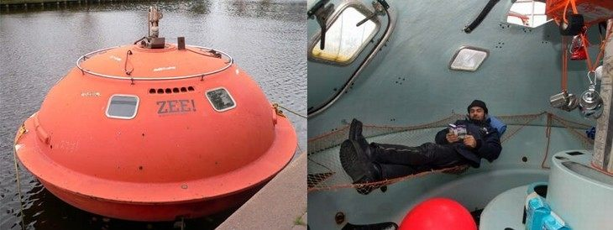
Middle Market Model
Target Audience: Backpackers/Travelers
Pricing: $30-50 range
Includes additional commodities:
  Lounge area, dining area, larger storage units inside pods
Located in popular tourist locations:
  Hollywood
  San Francisco
  Yosemite National Park
  Lake Tahoe
  Sequoia National Park
Communal aspects allows travelers to meet people, make connections- Novelty appeal
“A lot of travelers just want the basics and all the necessities… ‘affordable luxury.’ They want a room that offers their essential needs, fast Wi-Fi, somewhere to charge their iPads and work from a small desk if necessary. They don’t need a stacked minibar and other ancillary offerings…” (Forbes, 2017)
(Forbes, 2017)
Notes:
Ado

Slide 11
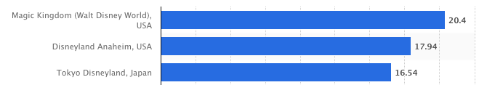
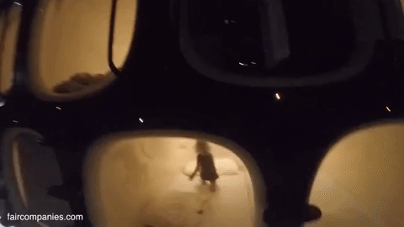
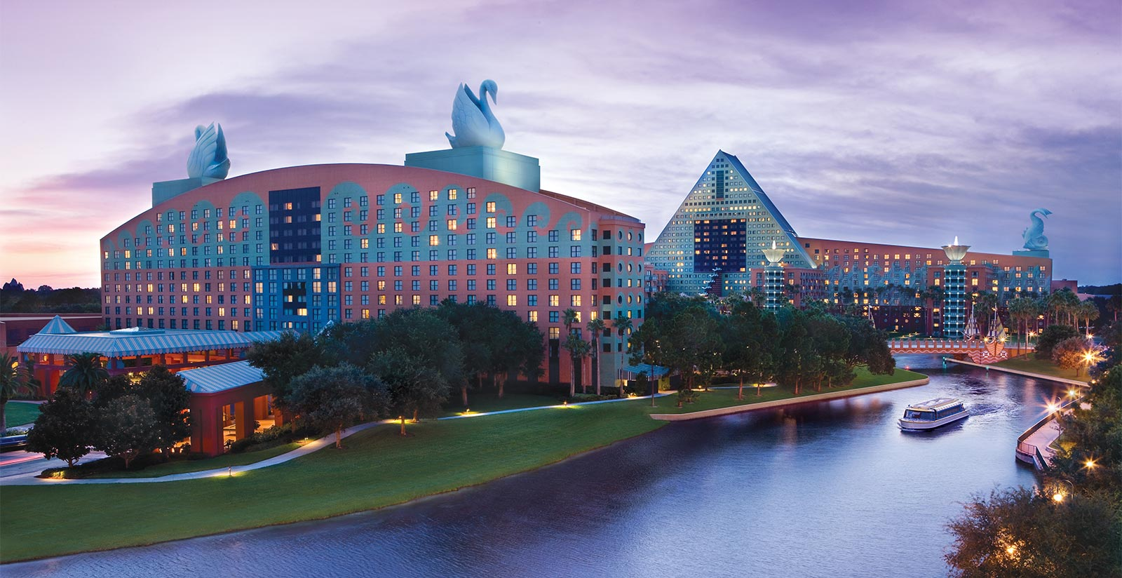
Luxury Model
Attendance (in millions)
Target Audience: Families
Joint-Venture with Disneyland
  Capsule Hotel model altered to a “nap room” model for children
  Creating two nap rooms in Disneyland Anaheim and DisneyWorld Florida would increase exposure by 232% compared to Tokyo’s Disneyland
Children are much more open and eager to the idea of sleeping in a pod
With Disney, the capsules would be themed off of Disney characters
Would only include sleeping pod
First hour: $15; Subsequent hours: $5
https://www.youtube.com/watch?v=ZsK8W7Rz1Pw
(Amusement and theme park attendance worldwide, 2016)
Notes:
Ado

Slide 12
S.W.O.T. Analysis
Notes:
None

Slide 13
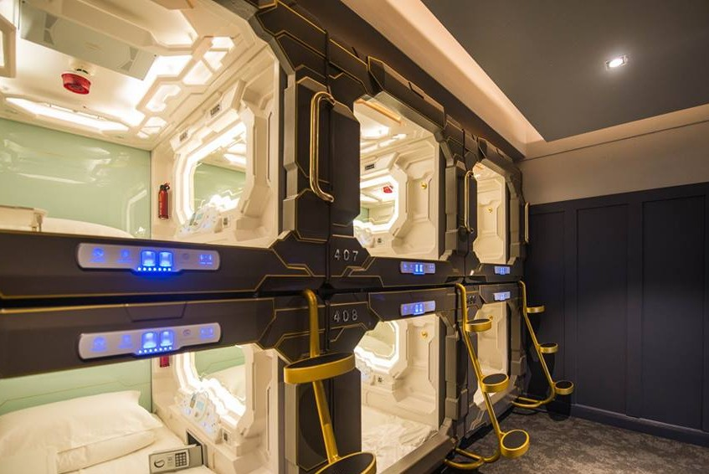
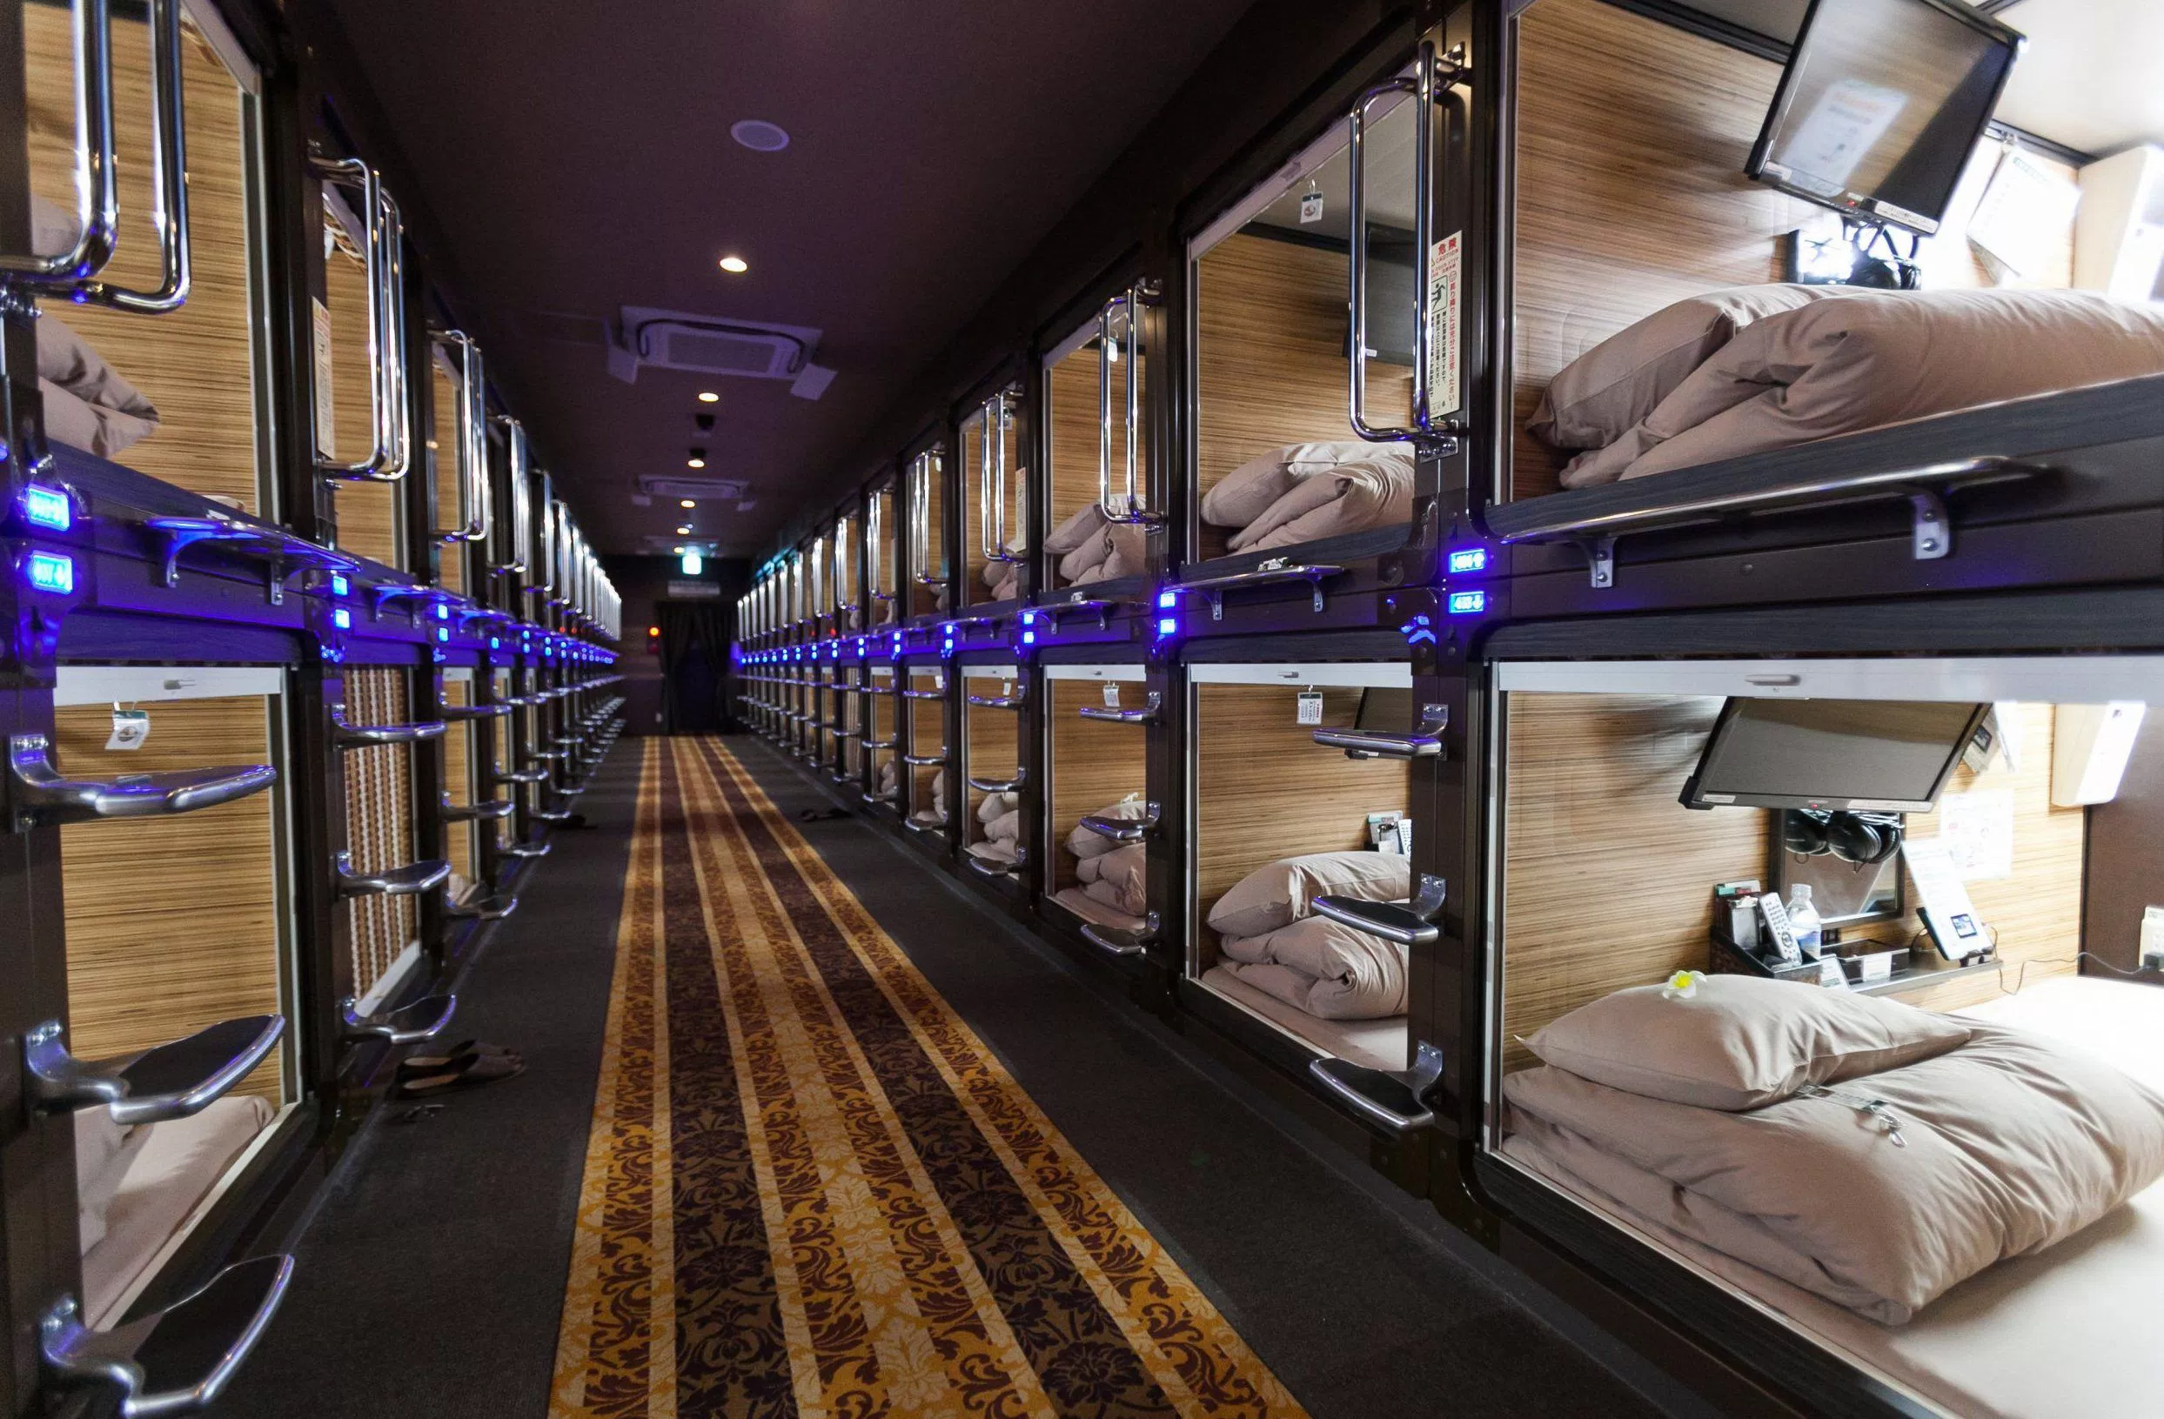
Strengths
Low cost to provide our services
Low price for consumers
Convenient location
Hotel layout may be attractive for young people
Flexibility: hourly or daily rate
  Daily rate: $30
  Hourly rate: $8 for the first hour, additional $2 per compounding hour
(Leighpanda, 2014)
Notes:
Matt

Slide 14
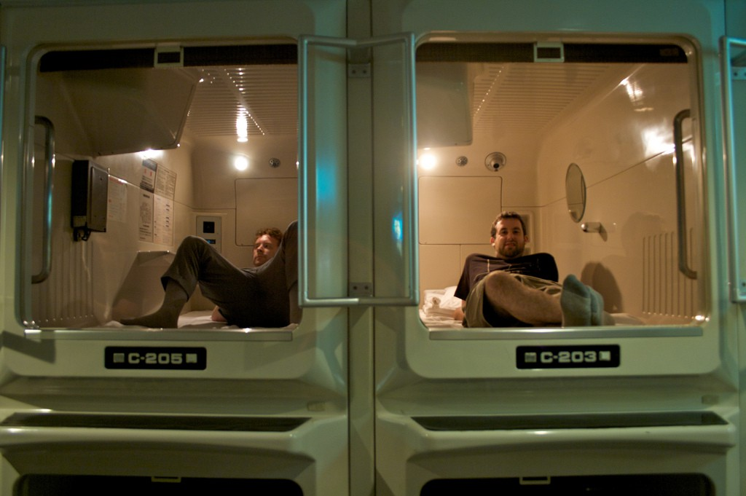
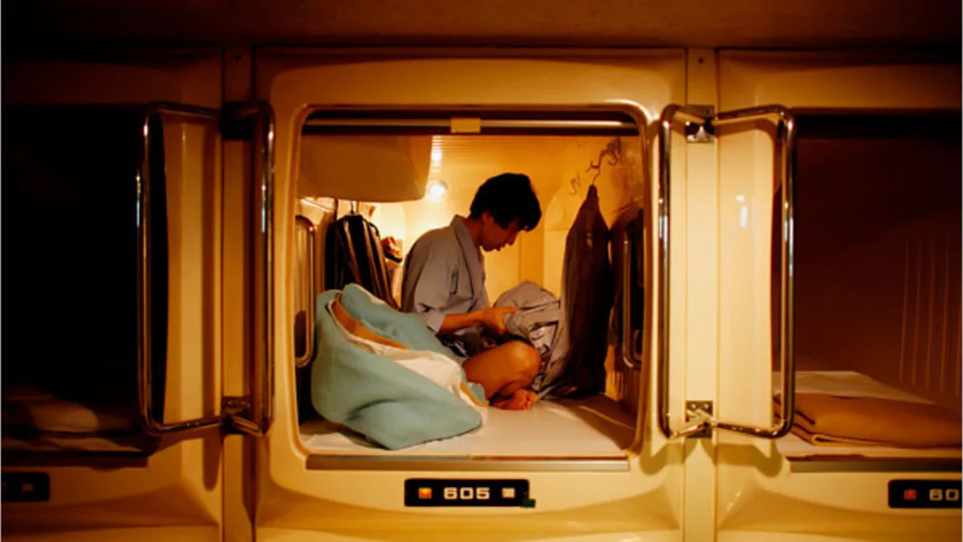
Weaknesses
Limited space (average: 6’7’’ x 3’3’’ x 4’1’’)
Not enough luxury (compared to larger hotels)
  Noisy, sound travels easily through pods
Not well known
Transfering from a collectivist to an individualist culture
  Americans would be hesitant to sleep inside of a pod
  Most are male only in Japan
(Leighpanda, 2014)
Notes:
Matt

Slide 15

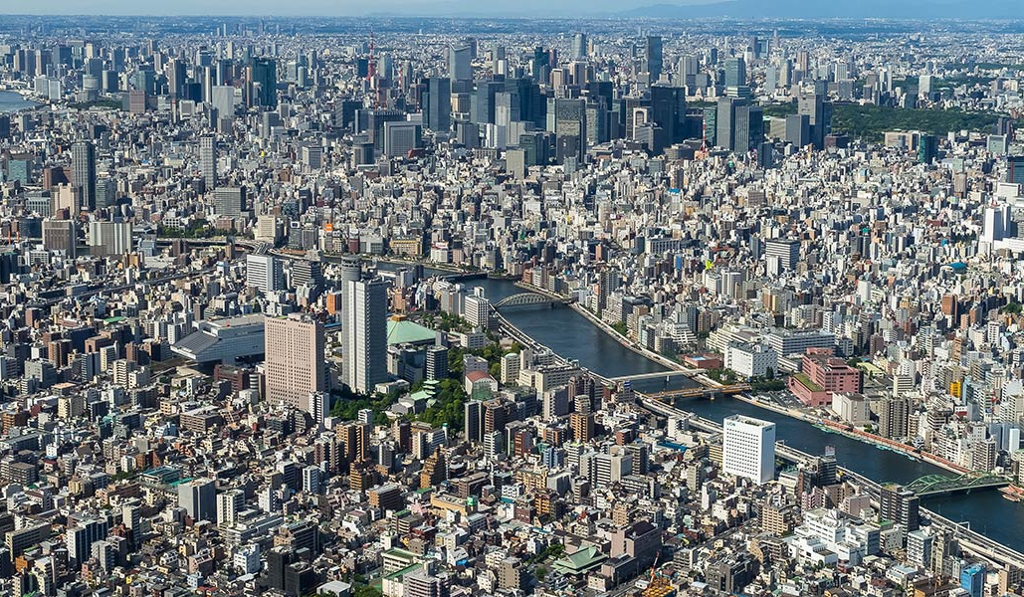
Opportunities
Expanding globally
  Compound Annual Growth Rate of 6.03%.
More customers in the summer (more traveling and tourism)
Demand has seen strong growth (WiseGuy Research Consultants)
Solve issues of housing in highly populated cities
(Forbes, 2017)
(Leighpanda, 2014)
Notes:
Matt

Slide 16
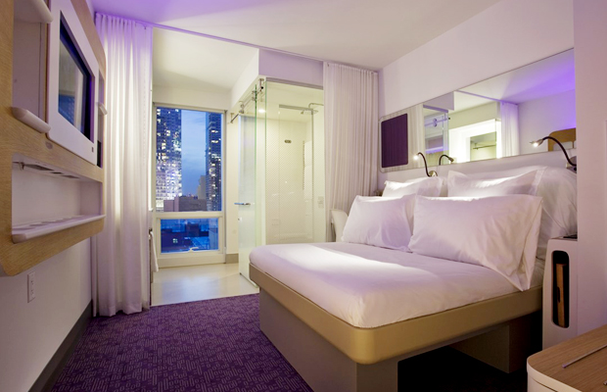
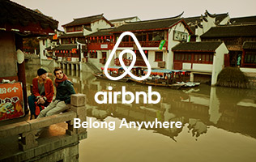
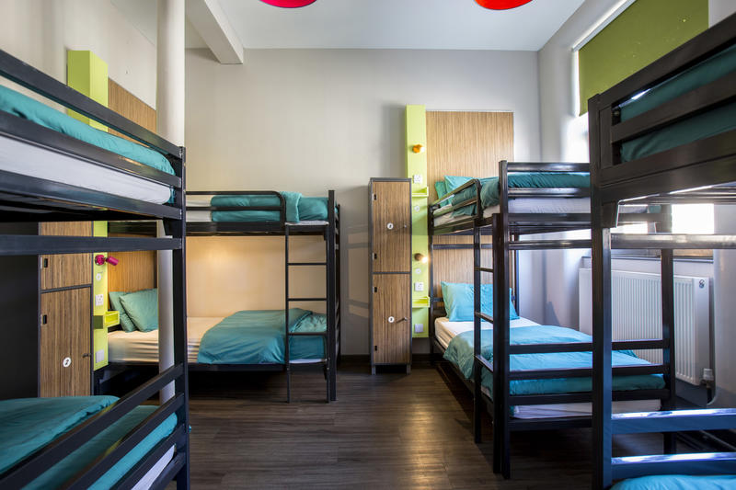
Threats
Strong competition
  Yotel
  Airbnb
  Hostels
Easy to be imitated
Meeting standards
  Fire safety
(Leighpanda, 2014)
Notes:
Matt

Slide 17
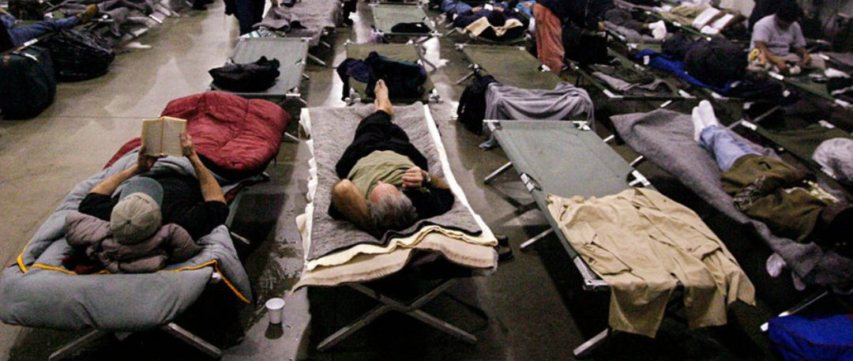
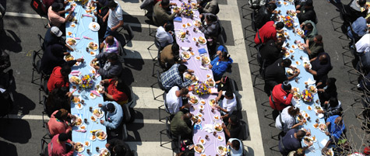
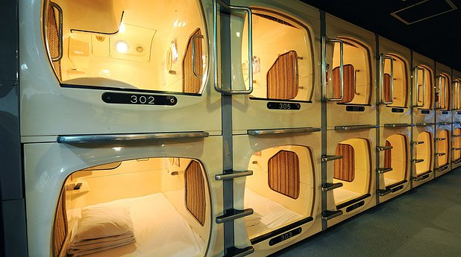
Our Recommendation
Bare-Bones Model
Population would be most accepting of a pod sleeping structure
  Are familiar with small cots to sleep on
  Would welcome the added privacy and security the pod provides
Justify this Japanese Corporation entering the U.S. because it would be solving the major issue of rising homelessness
  From 2016 to 2017 23% Increase in homeless individuals
Run into the problem of sanitation/security
  Non-profit model is self-improving and has the potential for expansion
(Los Angeles Homeless Services Authority, 2017)
Notes:
Abdulaziz

Slide 18

Plan of Action
Lots of land in LA in proximity to large amounts of homeless individuals: $100,000-$200,000
Construct a pod hotel containing 50 pods
  Construction period: 1 year
  $1,000-$2,000 per pod, totaling $50,000-$100,000
  $200,000 for all other facilities/costs
  Total expenditures: $250,000-$500,000
14-15 Positions:
  5 Management positions: CEO, VP of Sales, Treasurer, Operations, General Manager
  5 Sanitation workers
  2 Receptionists
  2-3 Security Guards
Finalized hotel will include:
  Sleeping pods
  Showers and Bathrooms
  Moderate level of sanitation and security
Improve facilities gradually over time and then move onto expansions to different segments of LA
(Adverts Marketplace Ltd., 2018)
(Bunk Pod - Side Entry)
(Point2 Homes)
Notes:
Abdulaziz

Slide 19

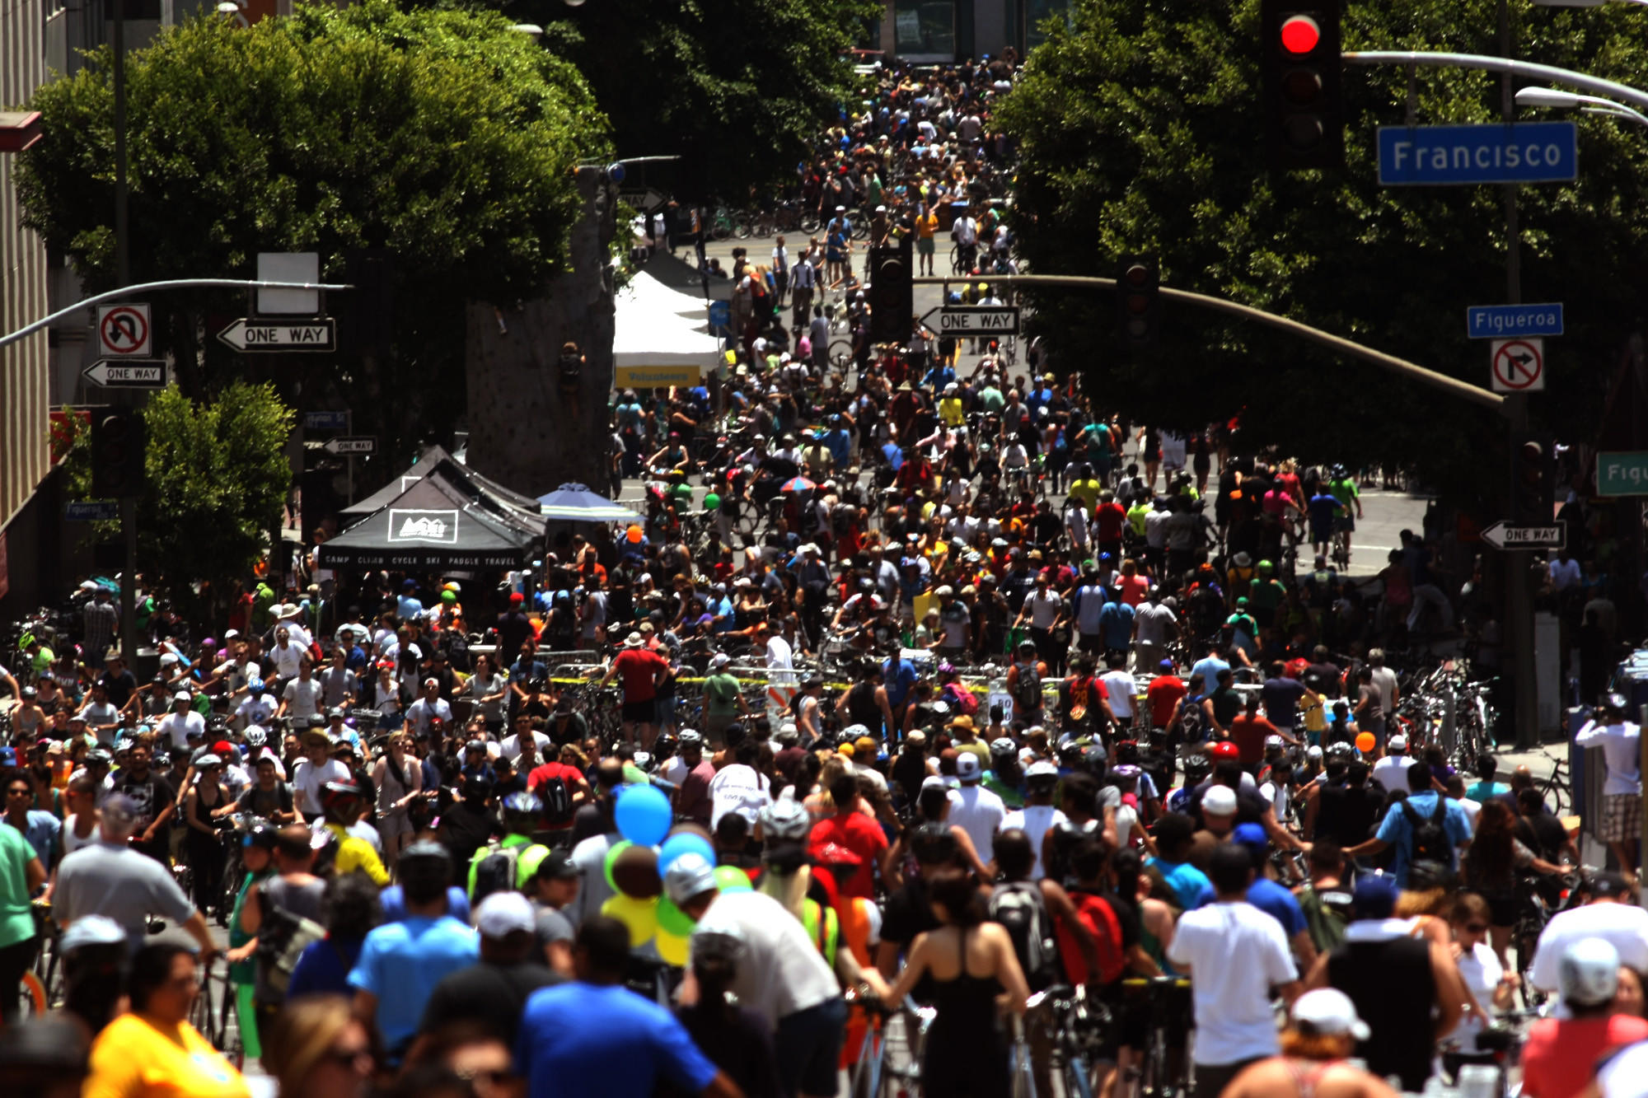
Managerial Implications
Must receive feedback from the guests in order to identify strategies for improvement.
  Through anonymous written feedback boxes, or simple social interaction with the population
Must be actively involved in ensuring that the hotel staff is maintaining the individual amenities and shared lounge/bathrooms.
  Sanitation, especially among the homeless, is a priority.
  Security is our second key emphasis due to the location.
  Sanitation and security staff will be engaged in 360 Degree Feedback loops, in which employees receive feedback from all levels of positions around them.
Pricing strategy: penetration
  We will set low prices to reach a larger portion of the market.
Since our capsule hotels are located in LA, a diverse, multicultural hub, we will have a polycentric approach.
(Iqbal, 2011)
Notes:
Abdulaziz

Slide 20
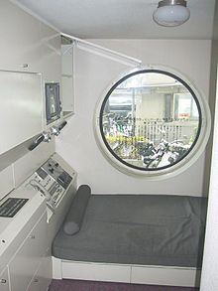
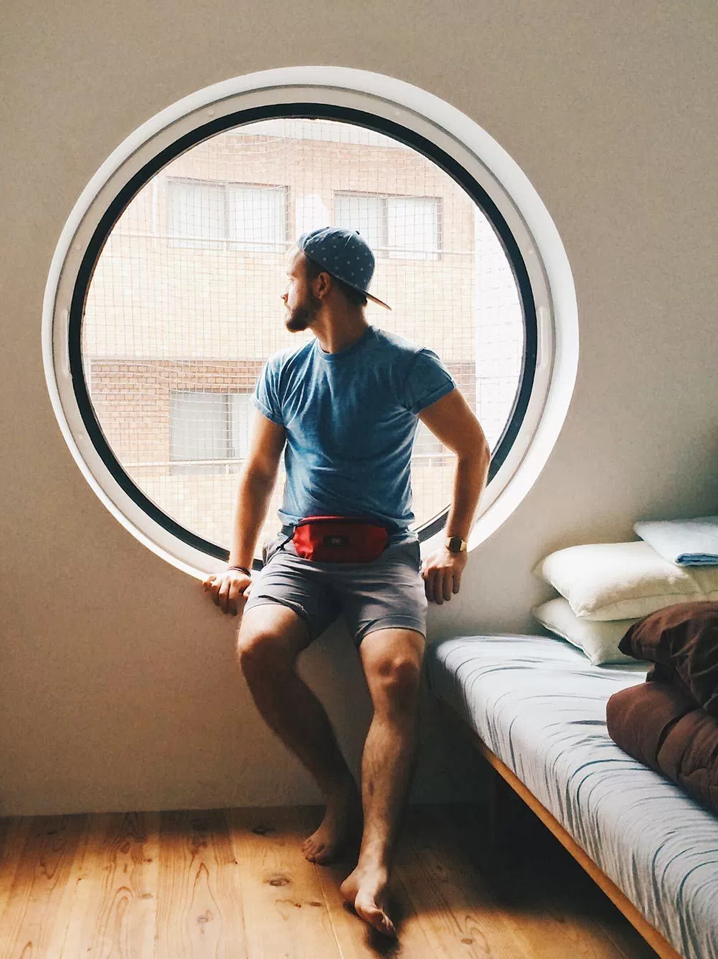
In Conclusion
Define “Capsule Hotel”
History of Capsule Hotels
  Japan, Asia, Europe, and U.S.A.
Japanese vs. American Culture
Three Market Options
  Bare-Bones Model
  Middle Market Model
  Luxury Model
S.W.O.T. Analysis
Our Recommendation
  Plan of Action
  Managerial Implications
Notes:
Ado

Slide 21
Any Questions?
Notes:
Ado

Slide 22
References
10 great places to sleep in a stylish pod hotel. (30 Nov. 2012). USA Today. Retrieved on 11 Apr. 2018, from
https://www.usatoday.com/story/travel/destinations/10greatplaces/2012/11/30/10-great-places-to-sleep-in-a-pod-hotel/1736613/
Adverts Marketplace Ltd. (2018, February). Japanese Style Sleeping Pods And Capsules For Sale For Sale in Dun Laoghaire, Dublin
from exce11ent. Retrieved April 12, 2018, from https://www.adverts.ie/other/japanese-style-sleeping-pods-and-capsules-for-sale/11586045
Amusement and theme park attendance worldwide 2016 | Statistic. (n.d.). Retrieved April 11, 2018, from
https://www.statista.com/statistics/194247/worldwide-attendance-at-theme-and-amusement-parks-since-2010/
Bunk Pod - Side Entry. (n.d.). Retrieved April 12, 2018, from http://www.podtime.co.uk/podtime_bunk_pod_side_entry.html
"Capsule comfort comes to Mexico City airport”. (31 Aug 2017). Aol. Retrieved on 11 Apr. 2018, from
https://www.aol.com/article/news/2017/08/31/capsule-comfort-comes-to-mexico-city-airport/23193051/#
“China’s first capsule hotel opens in Xi’an”. (14 May, 2012). CNN Travel. Retrieved on 11 Apr. 2018, from
http://travel.cnn.com/shanghai/life/chinas-first-capsule-hotel-opened-xian-543024/
Country Comparison. (n.d.). Retrieved April 11, 2018, from https://www.hofstede-insights.com/country-comparison/japan,the-usa/
Gudykunst, W. B., & Nishida, T. (1994). Bridging Japanese/North American differences. Thousand Oaks, Calif.: Sage Publ.
“India’s first ‘pod hotel’ has opened in Mumbai; so when are you packing your bags?”. (13 Apr 2017). The Indian EXPRESS.
Retrieved on 11 Apr. 2018, from
http://indianexpress.com/article/lifestyle/destination-of-the-week/indias-first-pod-hotel-has-opened-in-mumbai-so-when-are-you-packing-your-bags-4611813/
Iqbal, T. (2011). The impact of leadership styles on organizational effectiveness: Analytical study of selected organizations in IT sector in
Karachi. Munich: Grin Verlag.

Slide 23
References
Japan Info. "4 Things You Didn’t Know About Capsule Hotels – Japan Info". Japan Info, 2015, http://jpninfo.com/12996 Accessed 11
Apr 2018.
Leighpanda. (2014, September 09). Bloge 2 : Product of the Capsule Hotel. Retrieved April 12, 2018, from
https://leighpanda.wordpress.com/2014/09/09/bloge-2-product-of-the-capsule-hotel/
Los Angeles Homeless Services Authority. (2017, June). 2017 Greater Los Angeles Homeless Count Results. Retrieved April 11, 2018,
from http://www.vchcorp.org/wp-content/uploads/2017/06/2017-Homeless-Count-Results.pdf
Point2 Homes. (n.d.). Retrieved April 12, 2018, from
https://www.point2homes.com/US/Land-For-Sale/CA/Los-Angeles/Downtown-Los-Angeles.html?location=East LosAngeles,Los Angeles,CA&search_mode=location&PriceMax=800,000&page=1&SelectedView=listings&location_changed=true&ajax=1
Product of the Capsule Hotel. (September 9, 2014). Leighpanda
https://leighpanda.wordpress.com/2014/09/09/bloge-2-product-of-the-capsule-hotel/
“Reykjavík’s first Capsule Hotel offers offers Japanese-style sleeping pods”. (15 Jan, 2016 ). Icelan magazine. Retrieved on 11 Apr.
2018, from http://icelandmag.is/article/reykjaviks-first-capsule-hotel-offers-offers-japanese-style-sleeping-pods
Sharon Lam, “Asia's Booming Pod Hotel Market Projected To Reach $226M -- Why Are Travelers Downsizing?”. FORBES, 2017,
https://www.forbes.com/sites/lamsharon/2017/09/17/capsule-hotels-sweeping-asia/#11eb00d076e9 Accessed 11 Apr 2018
“Sleeep capsule hotel opens in Hong Kong”. (23 Feb 2017). Boutique Hotel New. Retrieved on 11 Apr. 2018, from
http://www.boutiquehotelnews.com/home/news/2017/2/23/sleeep-capsule-hotel-opens-in-hong-kong/
Stepanski, K. (2017). Challenges of a General Manager in a Hotel. Small Business Chron. Retrieved on 11 Apr. 2018, from
http://work.chron.com/challenges-general-manager-hotel-21993.html
Stott, R. (2017, April 08). Spotlight: Kisho Kurokawa. Retrieved April 11, 2018, from
https://www.archdaily.com/616907/spotlight-kisho-kurokawa
“Trend alert: Belgium opens Europe's first capsule hotel”. (25 Sep, 2014). CTV New. Retrieved on 11 Apr. 2018, from
https://www.ctvnews.ca/lifestyle/trend-alert-belgium-opens-europe-s-first-capsule-hotel-1.2025681
Walmsley, Katie. "Yotel: Will Americans Take To Tiny Hotels?". ABC News, 2011,
http://abcnews.go.com/Travel/yotel-offers-tiny-capsule-hotels-united states/story?id=13867592. Accessed 11 Apr 2018.

